Slide 1
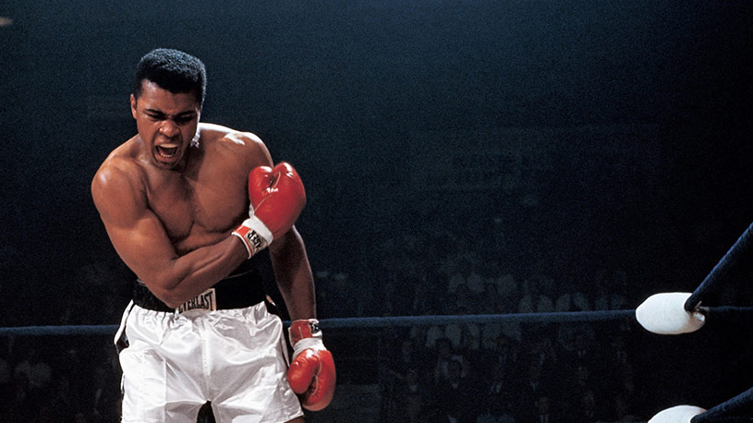
The Black Boxers
March Data Crunch Madness 2021

Slide 2
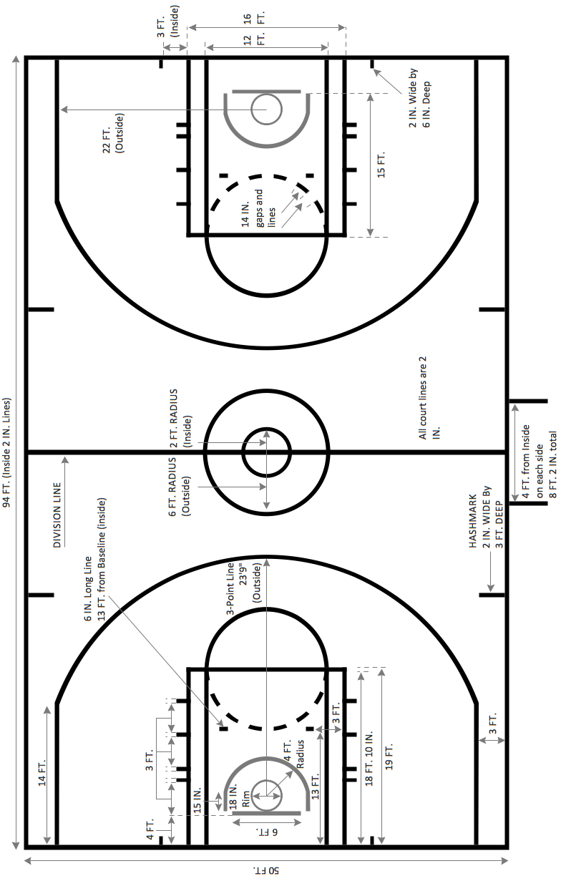

The Game Plan
Creative Transformation
Base Variable Selection
Model Selection
Thinking Outside the Box
0
0
Notes:
Methodology
Base variable: mean/PCA analysis
Creative transformation: transforming variables for better effectiveness
Model selection: implementation of prediction models and rendering their accuracies
Thinking outside the box: retrieving data from outside our historical dataset

Slide 3
Variable Selection
Mean Analysis
Principal component analysis (PCA)
Ranked variables by difference of their means
Removed variables with correlation over 0.8
Method of dimensionality reduction
Transformed our extensive set of variables into a smaller one
Retained most of the information from the extensive set
2
0
Notes:
Mean Analysis: Ranked variables based on the difference of their means and removed variables with lower importance when they are correlated more than +80
PCA: A dimensionality reduction method that is often used to reduce dimensionality of large data sets by transforming a more extensive set of variables into a smaller one that still retains most of the information from the more extensive set.

Slide 4
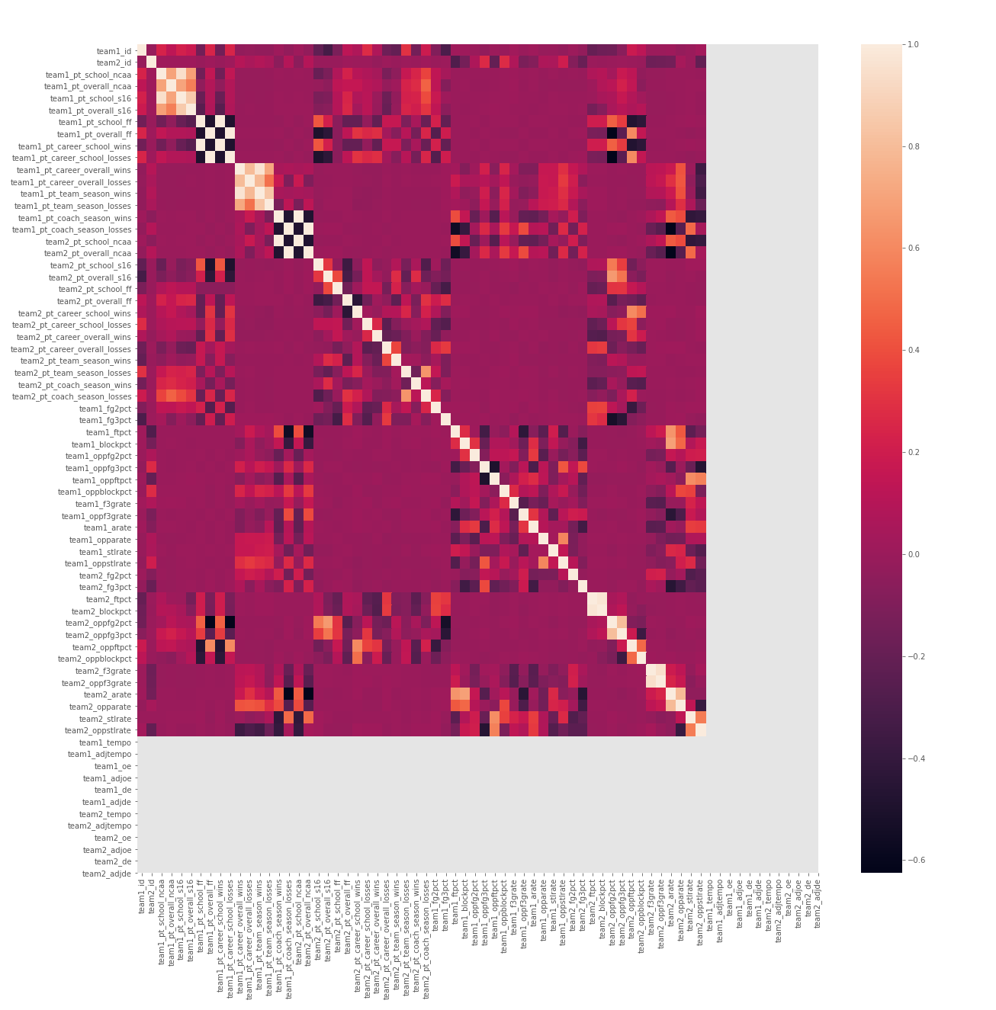

Base variable selection
The heat map shows correlation of a variable to a team’s average winning score surplus
The top 10 correlated variables were chosen to create an initial evaluation for model performance
This performance was our baseline to measure effectiveness of additions to our model
4
0
Notes:
Created a base for our model to evaluate an initial performance and our implementation of new variables
Correlation heat graph between selected variables by mean analysis and score surplus based on PCA
Darker color indicate a stronger correlation between variables.
Selected the 10 most correlated variables for our model

Slide 5
Variable Transformation
Net Efficiency
3-Point Differential
Coach Winning Probability
Efficiency Team Score
Creating the following variables allowed for more efficiency and effectiveness in our model:
Number of expected points by which team 1 will outscore team 2
Expected difference between two teams’ 3 point shooting percentage
Difference between 1 and the ratio of coach losses with a particular team over his career losses
Difference between Team 1 scoring efficiency and opposition scoring efficiency
6
0
Notes:
Net efficiency: A positive value indicates higher chances of team 1 winning and a negative value indicates higher probability of team 2 winning.
Coach winning probability: The probability of the team winning calculated by finding the difference between 1 and the ratio of losses the coach had with the particular team divided by the number of overall career losses

Slide 6
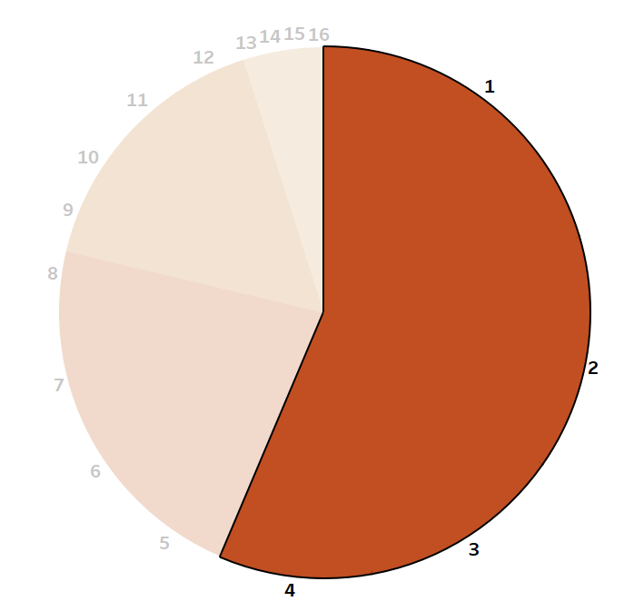
Seed Variable
Categorization of a team’s seed for improved effectiveness
Not everything is unpredictable in march madness!
It has been 16 years since anything but a first, second or third seed has won the NCAA title
14 times in the last 20 years the champion has been a No. 1 seed
37 of the last 40 teams to make the Final Four were a No. 5 seed or better
8
0

Slide 7
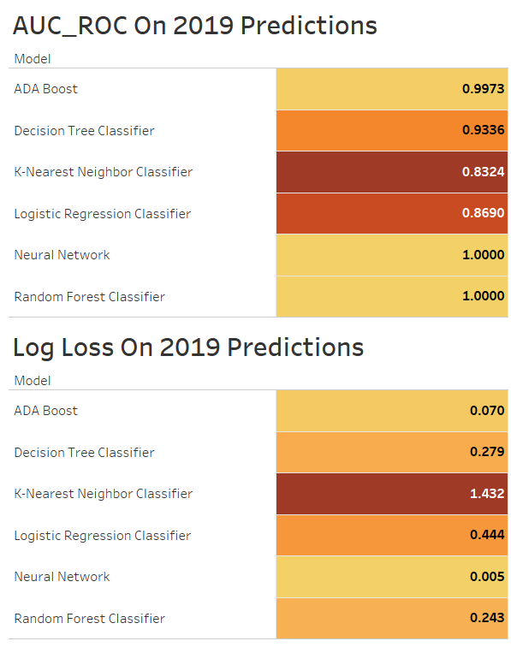
Model Comparison
By looking at the mode’s AUC_ROC and Log Loss, we can highlight models that have done well in 2019 predictions
Unfortunately, these models often return predictions of 0.01% and 99.99%, which is a threat to our potential log loss for the 2021 competition
10
0

Slide 8
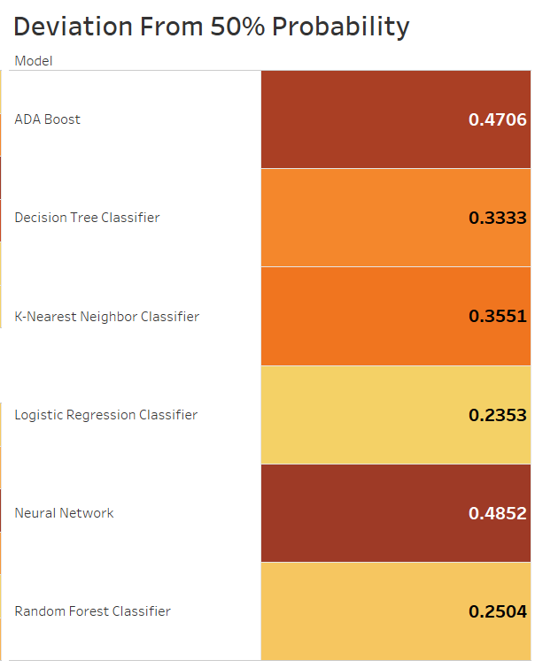
Model Comparison
To make sure we avoid that, we evaluate how the model’s average absolute prediction deviates from 50%
The lowest numbers tell us which models have the least extreme predictions, meaning they have the lowest amount of log loss liability
12
0

Slide 9
Consistent through all categories was the Random Forest Classifier
14
0

Slide 10
Non-Machine Learning Predictions
Three variables were used outside of our dataset to shift our final predictions:
COVID Affected Homeground
Sports Betting
A Dad’s Intuition
The lack of historical data did not stop us from using them in our predictions, we just had to use them after our model’s results
Depending on how the teams ranked on the variables above, their probabilities were modified by up to 10%
16
0
Notes:
For our predictions, we utilized three variables outside of our dataset: Dad’s Intuition, COVID Affected Homeground, & Sports Betting.

Slide 11
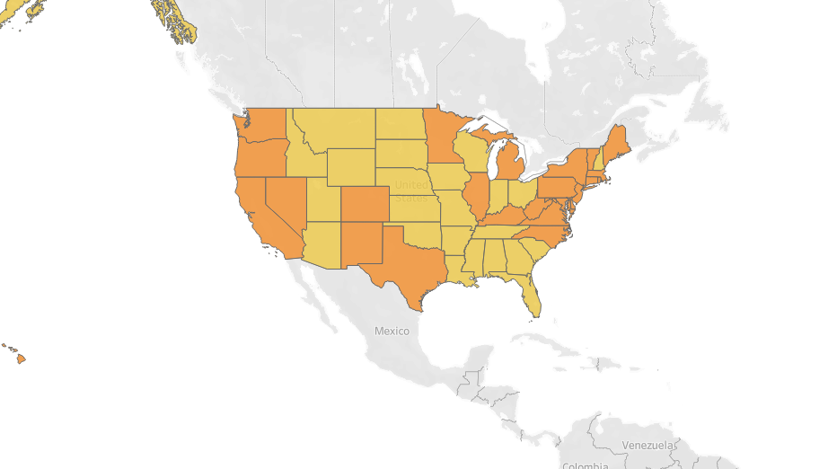
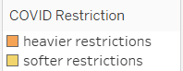
COVID-19 Affected Homeground
Categories based on:
Statewide School Restart
Large Gatherings Restrictions
Reopening of Restaurants and Bars
Strictness of “Shelter in Place” Order
These might affect a team’s capability to train as well as their morale
Based on a team’s home stadium longitude and latitude, we inferred the COVID-19 restrictions in their state and adjusted their final probabilities
18
9
0
0
Notes:
Could have affected moral & ability to practice

Slide 12
Sports betting Variable
Consulted the “Betting Market” to incorporate their opinion on first round games
“The Odds API” was used to pull betting odds from several sports bookies
Used “Fuzzy” matching to retrieve data towards the teams
Adjusted probabilities based on percentage of bets for/against
20
0

Slide 13

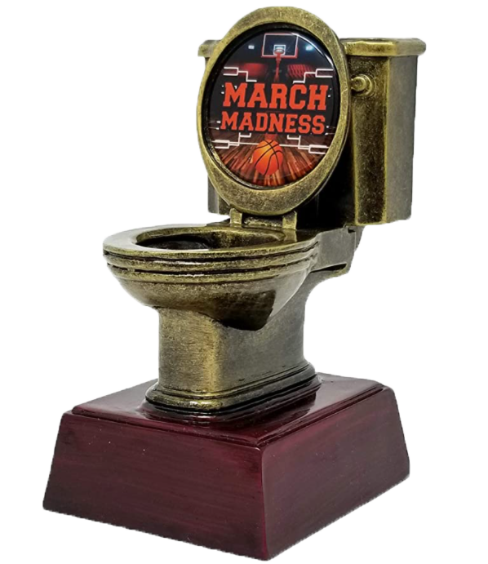
Dad’s Intuition
Our team’s diverse background from three different continents allowed us for plenty of creativity
The problem is, none of us know a thing about basketball
To compensate, we resorted to a friend’s dad’s intuition, to place teams in two categories:
Teams he thinks have high potential
Teams he thinks have low potential
We adjusted our final predictions based on the categorization above to ensure we were not missing some hidden knowledge only basketball followers know!
22
0

Slide 14
A Final Touch: De-extremizing Variables
f(x) = 2^{(x*10)}
9.98
Probabilities close to absolutes (0% or 100%) are liabilities for high log loss
So, we crafted an exponential formula to adjust our predictions increasingly by extremity
This formula allows a maximum change on a .99 or .01 prediction by 10%
Values below a .49 deviation from 50% would have exponentially decreased effects, so predictions close to 50% would have almost no adjustment
24
0
Notes:
This is an exponential formula that affects numbers increasingly the more extreme they are
(numbers close to .05 probability will barely affected, those higher than .09 can be modified by almost 10%)
9.98 is the value that would make a .99 or .01 prediction be affected by 10%

Slide 15
Conclusion
Creating Variables
Non-machine learning adjustments
Model Prediction
De-Extremizing
Final Probability
FINAL
24
0

Slide 16
Thank you!
From the Black Boxers Team:
David Graafland
Leonardo Luchetti
Sruthi Mudunuri
Tahsin Rakib Himi

